Slide 1
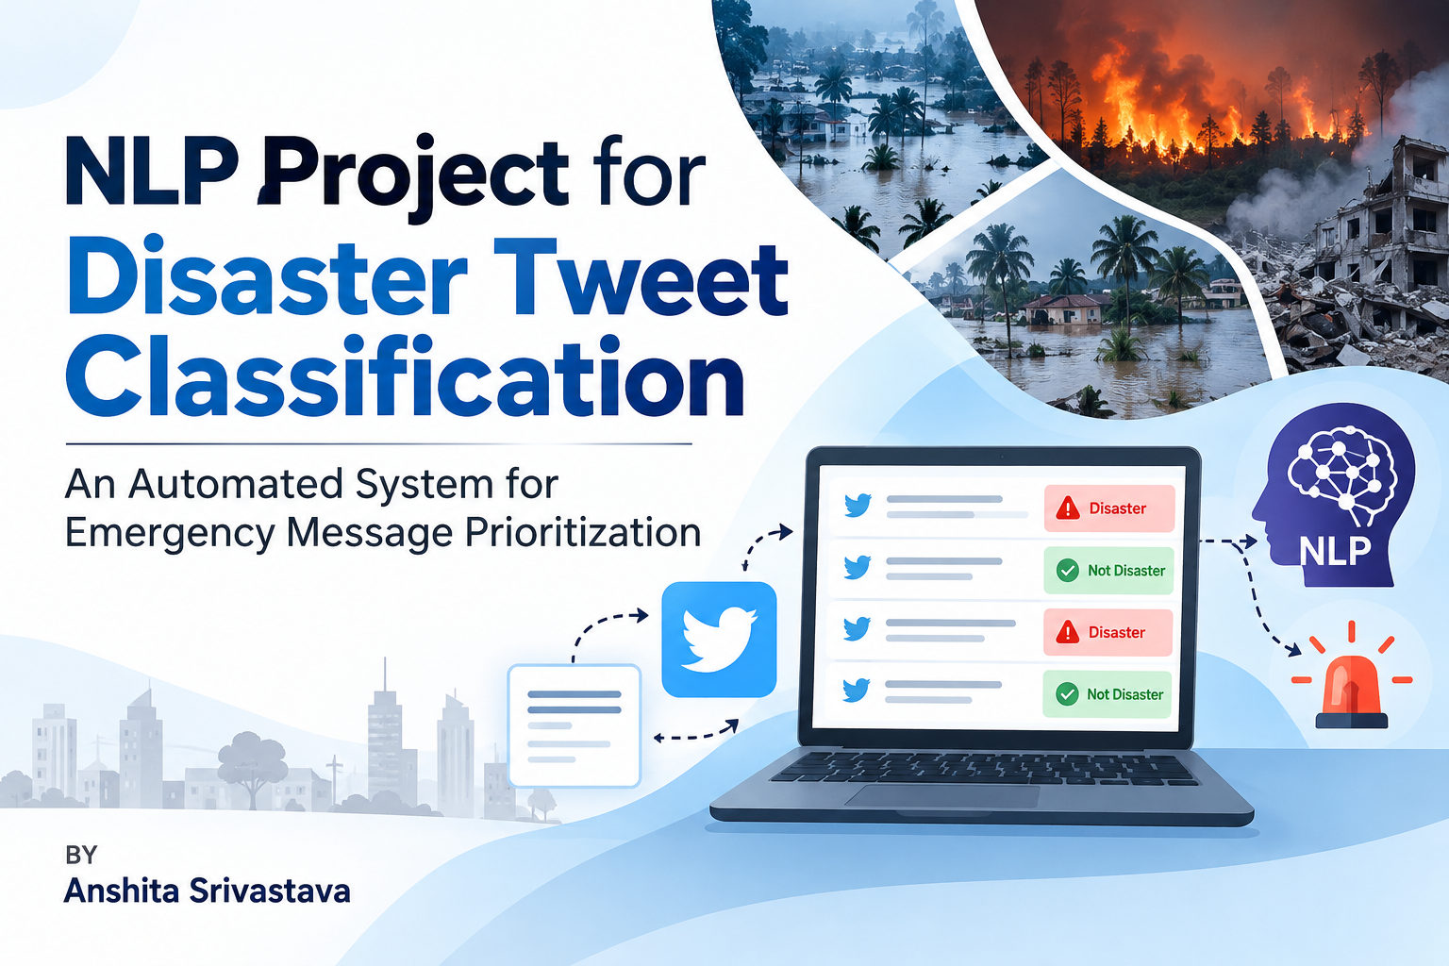

Slide 2
Introduction & Problem Statement • Real-Time Crisis Mapping:
Social media allows critical operational information to travel fast during emergencies. • Linguistic Ambiguity: Disaster-related terms frequently occur in figurative descriptions, metaphors, and casual banter. • Objective Challenge: To build a robust baseline classifier capable of separating real disaster reporting from contextually misleading statements. • Operational Scope: Serving as an automated alert priority filter while acknowledging that validation requires authoritative supervision.

Slide 3
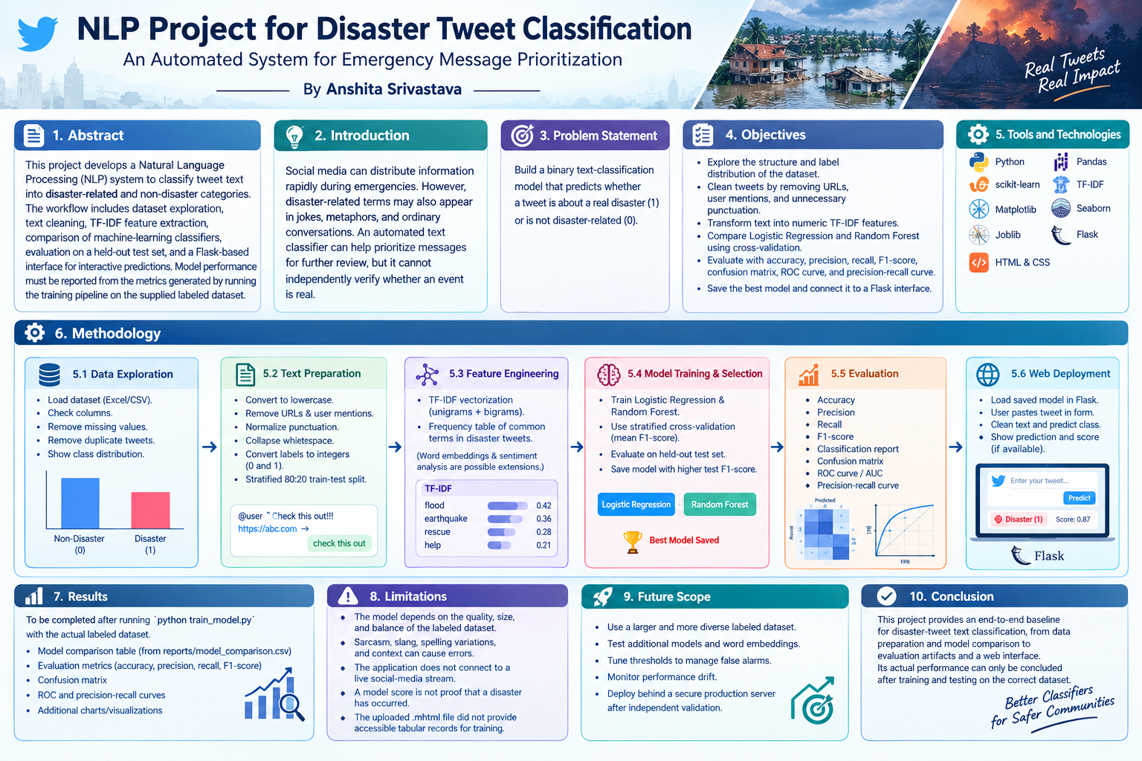

Slide 4
Project Objectives & Core Technologies Core Workflow Objectives:
• Perform systematic data cleaning, missing value checks, and duplicate mitigation.
• Structural analysis of class balance configurations via localized data splits.
• Model evaluations using standard performance profiles (Accuracy, Recall, Precision, F1).
• Encapsulate pipelines for deployment within interactive, localized environments.

Slide 5
Technical Framework Architecture:
Component Group Tools & Libraries Implemented Data & Engineering Python, Pandas, Joblib Features & Modeling scikit-learn (TF-IDF Vectorization, Logistic Regression, Random Forest) Analysis & Visuals Matplotlib, Seaborn Interface Deployment Flask Microframework, HTML, CSS

Slide 6
Data Engineering & Preprocessing Pipeline
• Data Cleaning Filters: Conversions to clean lower-case structures, deletion of URLs, text patterns, user mentions (@), and collapsing whitespace blocks.
• Target Encoding: Uniform indexing transforming categorical status into integer keys (0 for Non-Disaster and 1 for Real Disaster).
• Validation Architecture: Partitioned utilizing a Stratified 80:20 train-test split to preserve operational class distribution parameters across evaluations.
• Feature Transformation: Numeric text transformations leveraging a TF-IDF Vectorization stack tracking unigram and bigram structures.

Slide 7
Model Selection & Evaluation Strategy
• Pipeline Candidates: Simultaneous execution profiles configuring linear models (Logistic Regression) against tree ensembles (Random Forest).
• Validation Routine: Application of Stratified Cross-Validation on training subsets tracking mean F1 scores.
• Selection Rule: Performance selection is controlled by the pipeline demonstrating optimal F1 profiles on validation sets.
• Target Artifact Profiles: Generation of Confusion Matrices, Precision-Recall Curves, and ROC/AUC scores to analyze false-alarm boundaries.

Slide 8
Interactive Web Interface Deployment
• Interface Architecture: Lightweight integration leveraging a localized Flask microframework container.
• Dynamic Pipeline Evaluation: Serialized model and vectorizer instances are loaded using Joblib utility wrappers.
• Execution Workflow: Users input live string parameters into a web webform, forcing runtime parsing through the preprocessing pipeline.
• Operational Results: Displays classification class along with model probability confidence metrics where supported.

Slide 9
Project Constraints & Future Scope
• Contextual Vulnerabilities: Susceptibility to linguistic shifts such as dense slang, regional spelling variations, and complex sarcastic phrasing.
• Operational Limitations: Standalone model execution is isolated from direct real-time platform APIs or stream ingestion engines.
• Advanced Extensions: Migration from basic lexical counts toward rich semantic architectures including pre-trained Word Embeddings or Transformers.
• Production Scaling: Relocating from micro-servers into secure enterprise cloud APIs managing comprehensive drifting monitors.

Slide 10
Conclusion
This project provides an end-to-end baseline for disaster-tweet text classification, from data preparation and model comparison to evaluation artifacts and a web interface. Its actual performance can only be concluded after training and testing on the correct dataset.

Slide 11


